Slide 1
Урок вот-вот начнется.
Приготовься, сейчас будет что-то новенькое!

Slide 2

Docker
Basic Concepts

Slide 3

Architecture

Slide 4

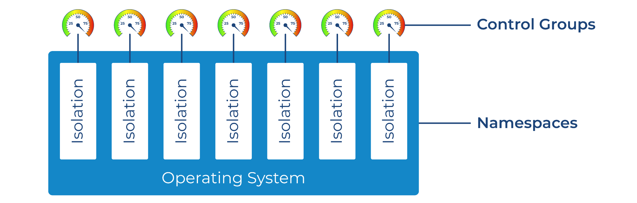
Container Itself

Slide 5
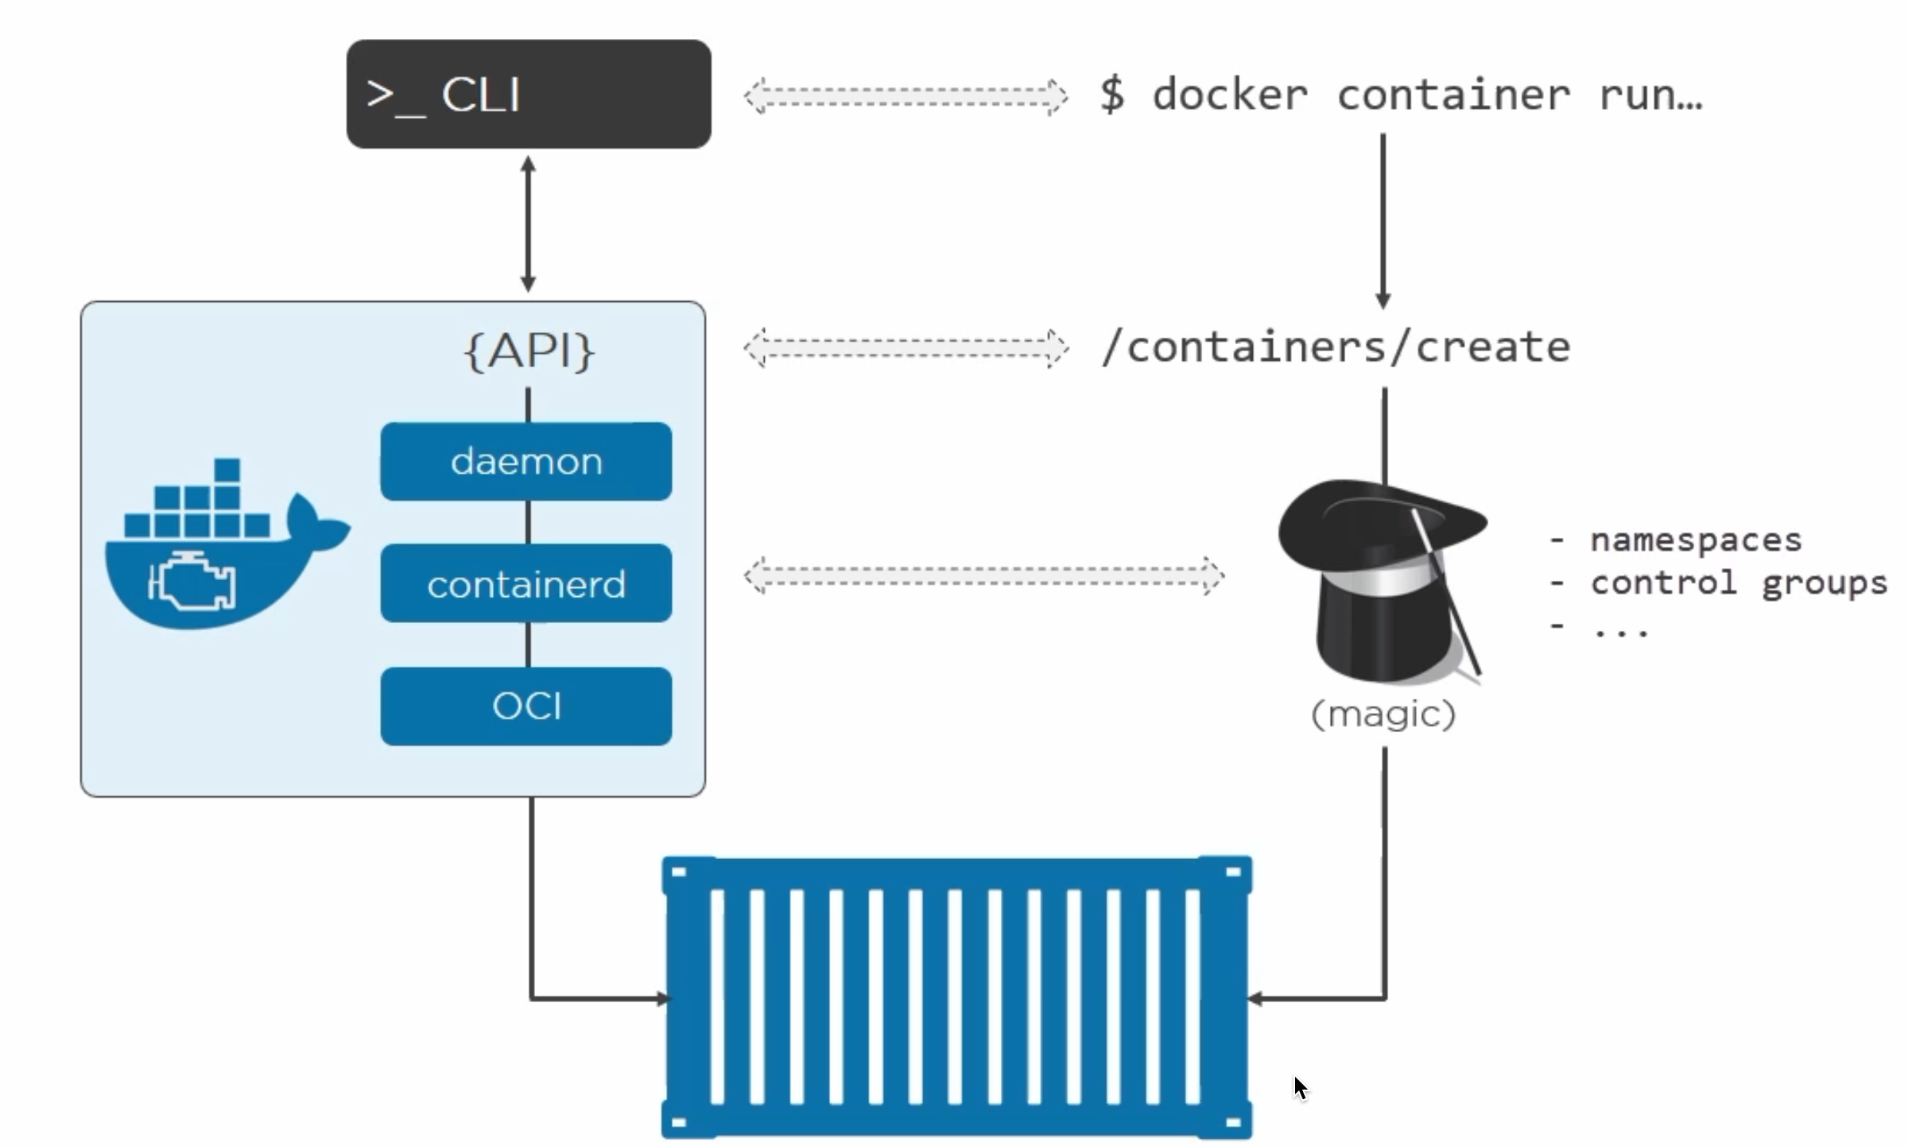
Docker Commands
Magic …

Slide 6
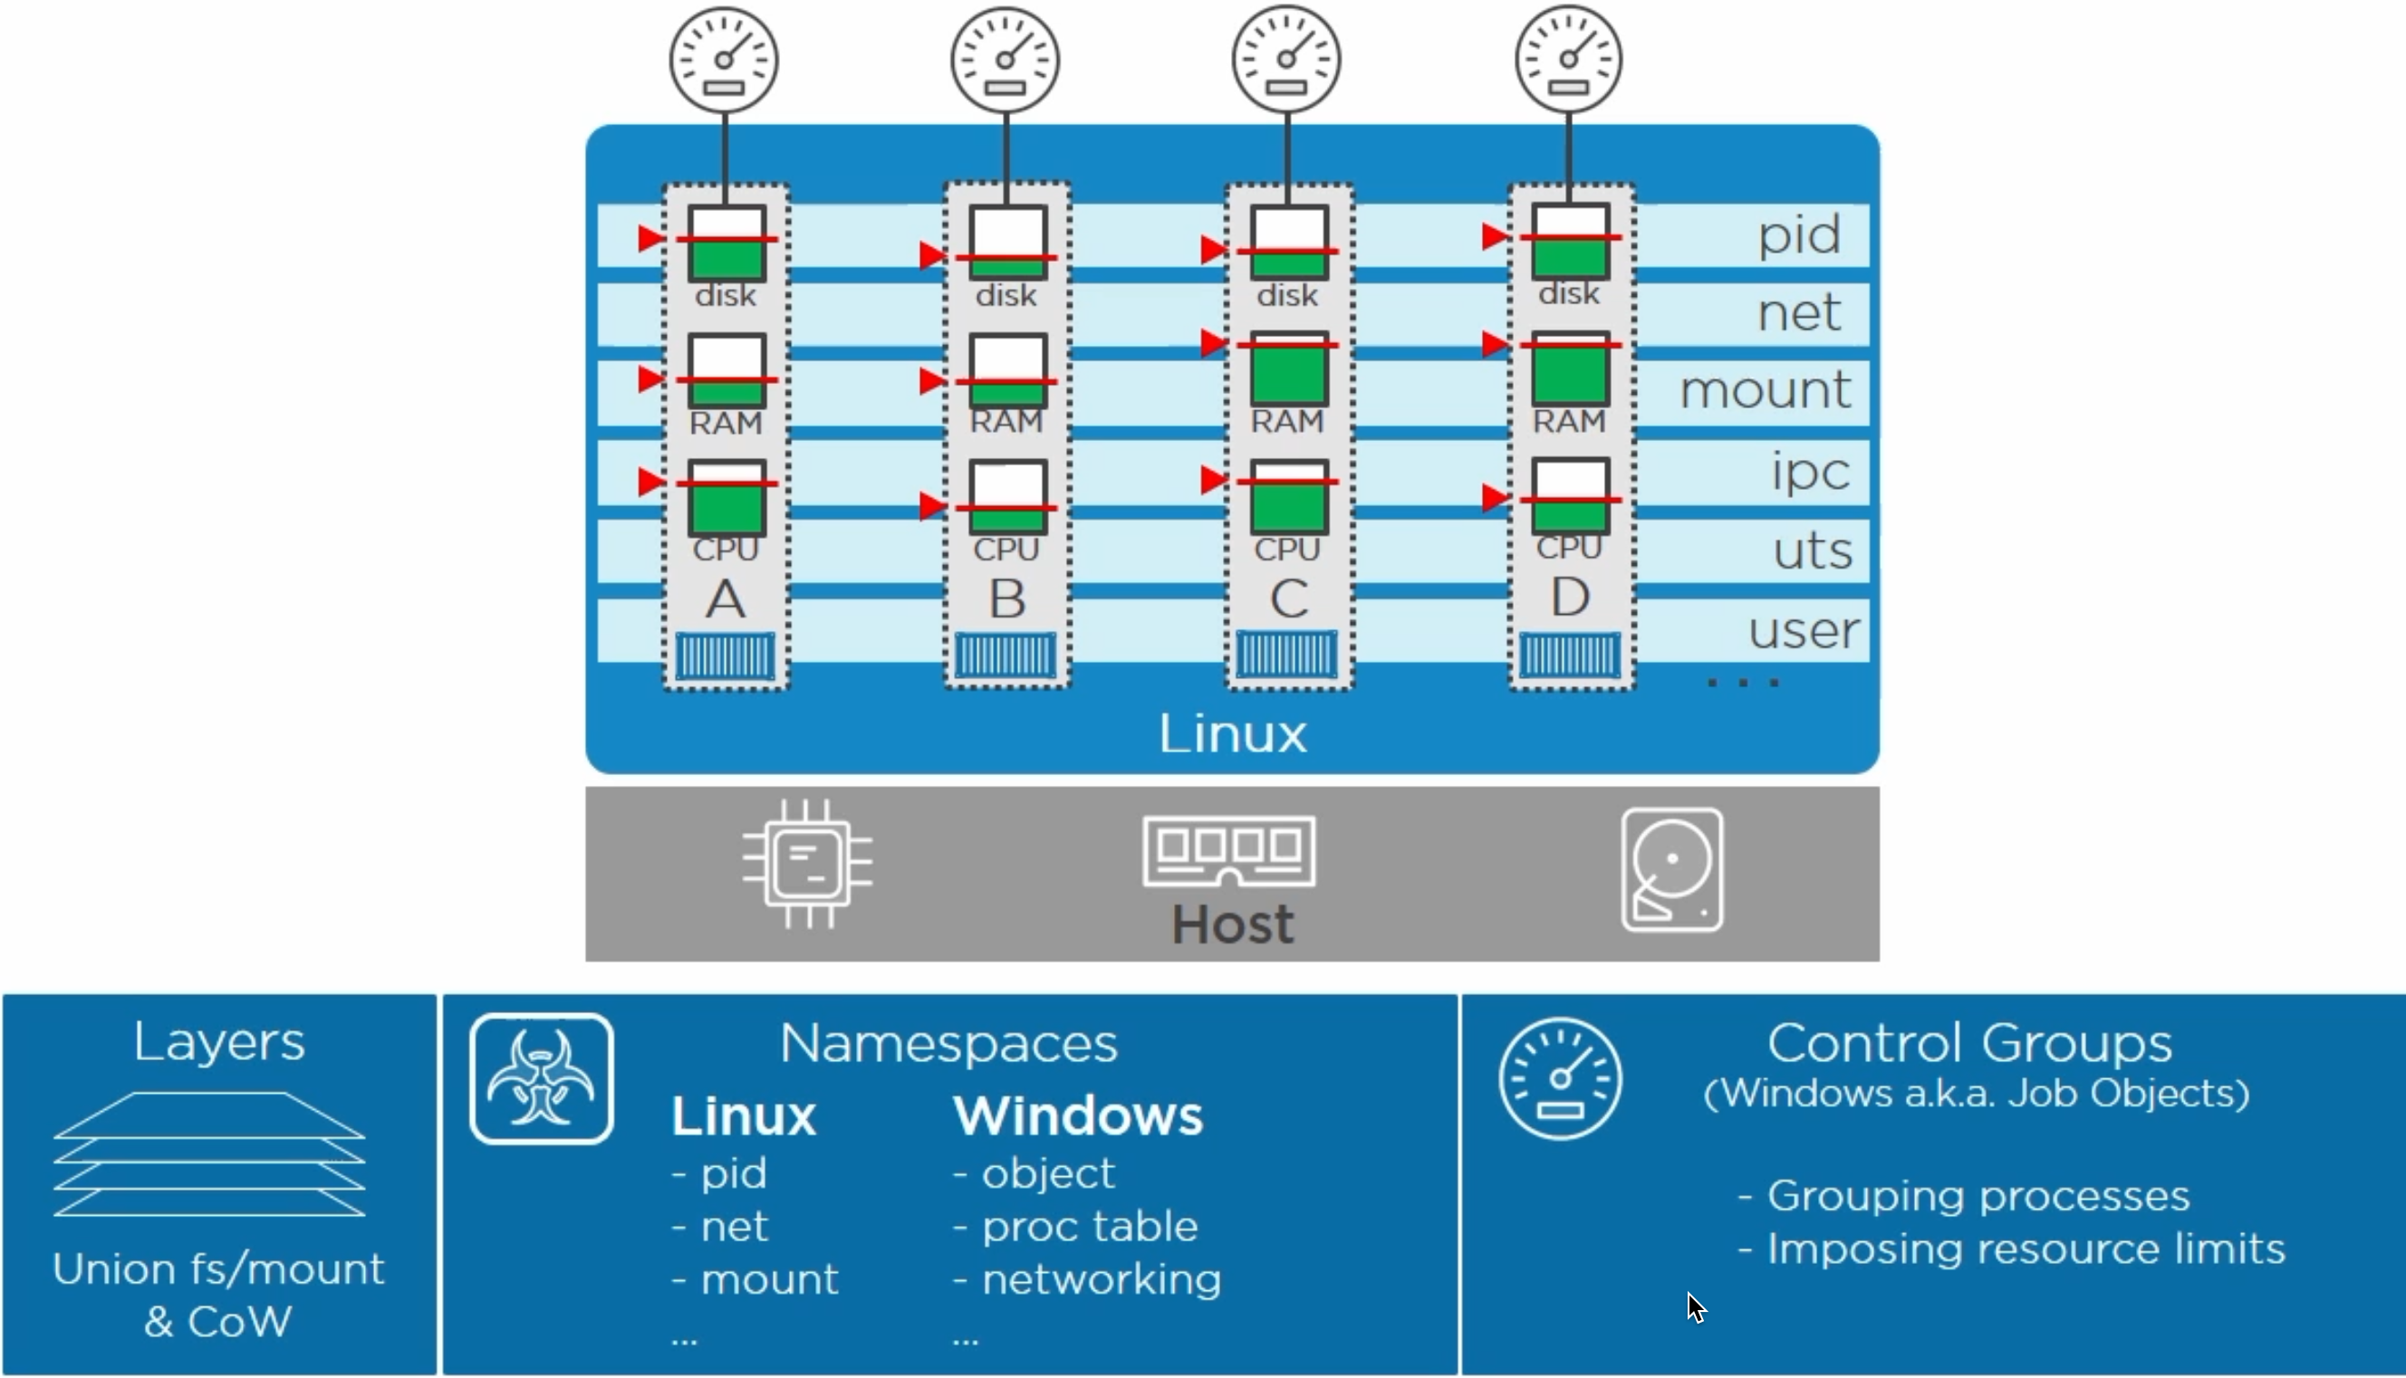
Linux and Windows

Slide 7
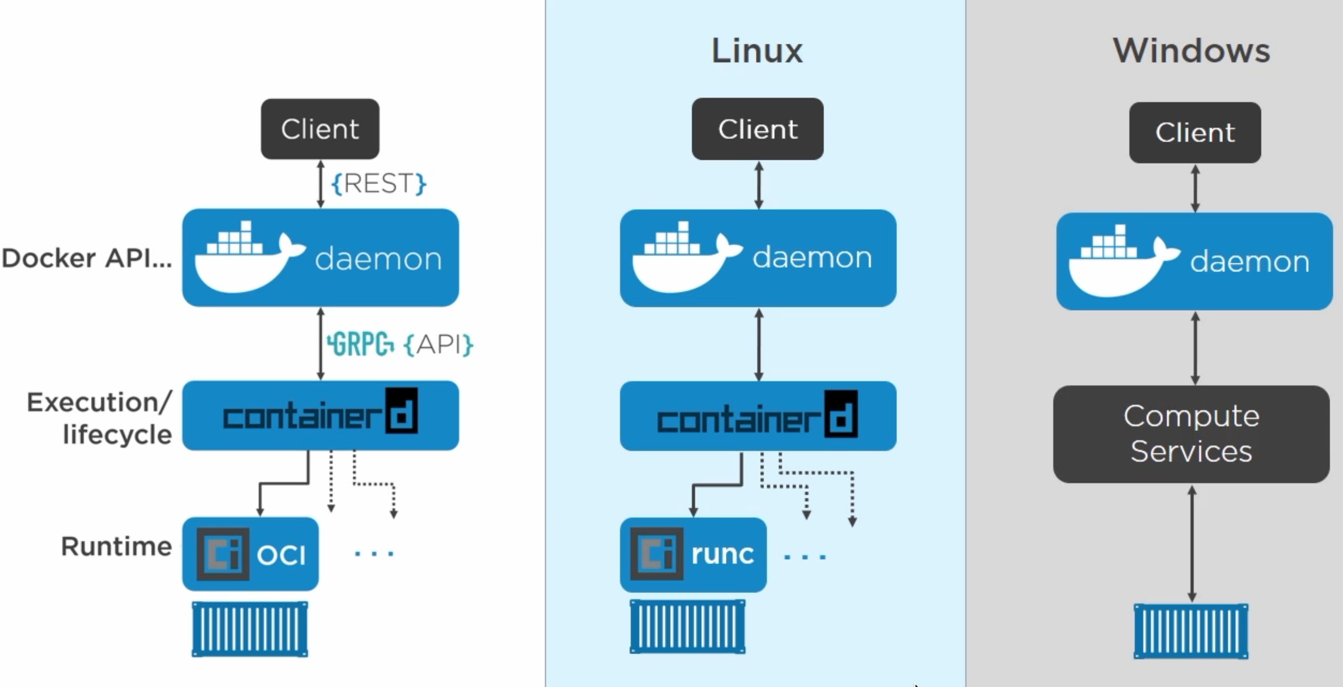

Docker Engine

Slide 8
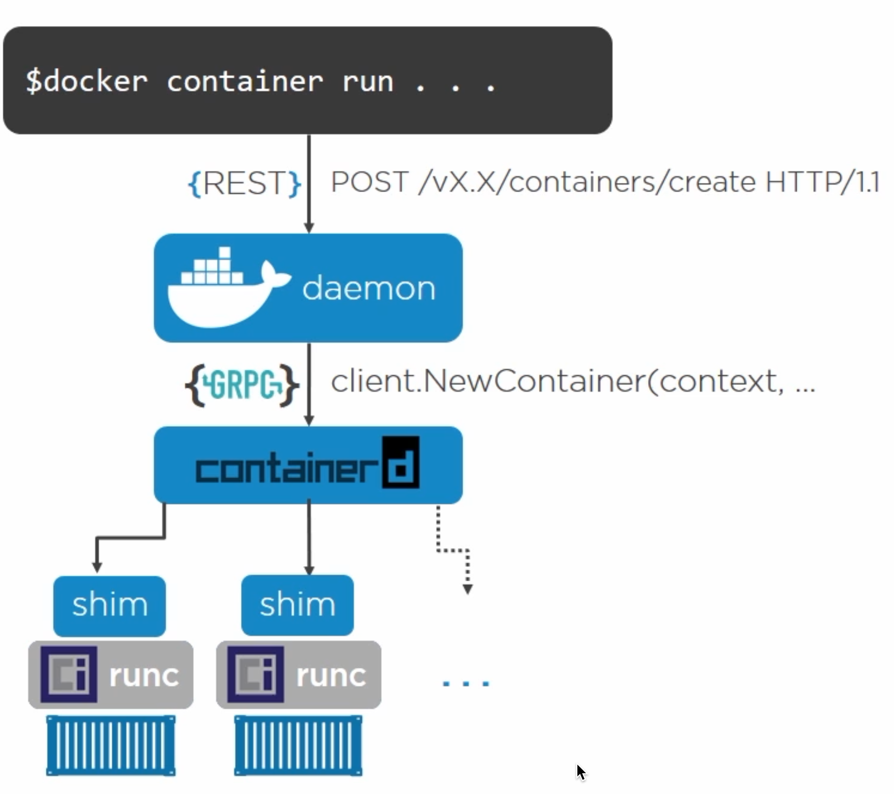

Slide 9

Images

Slide 10
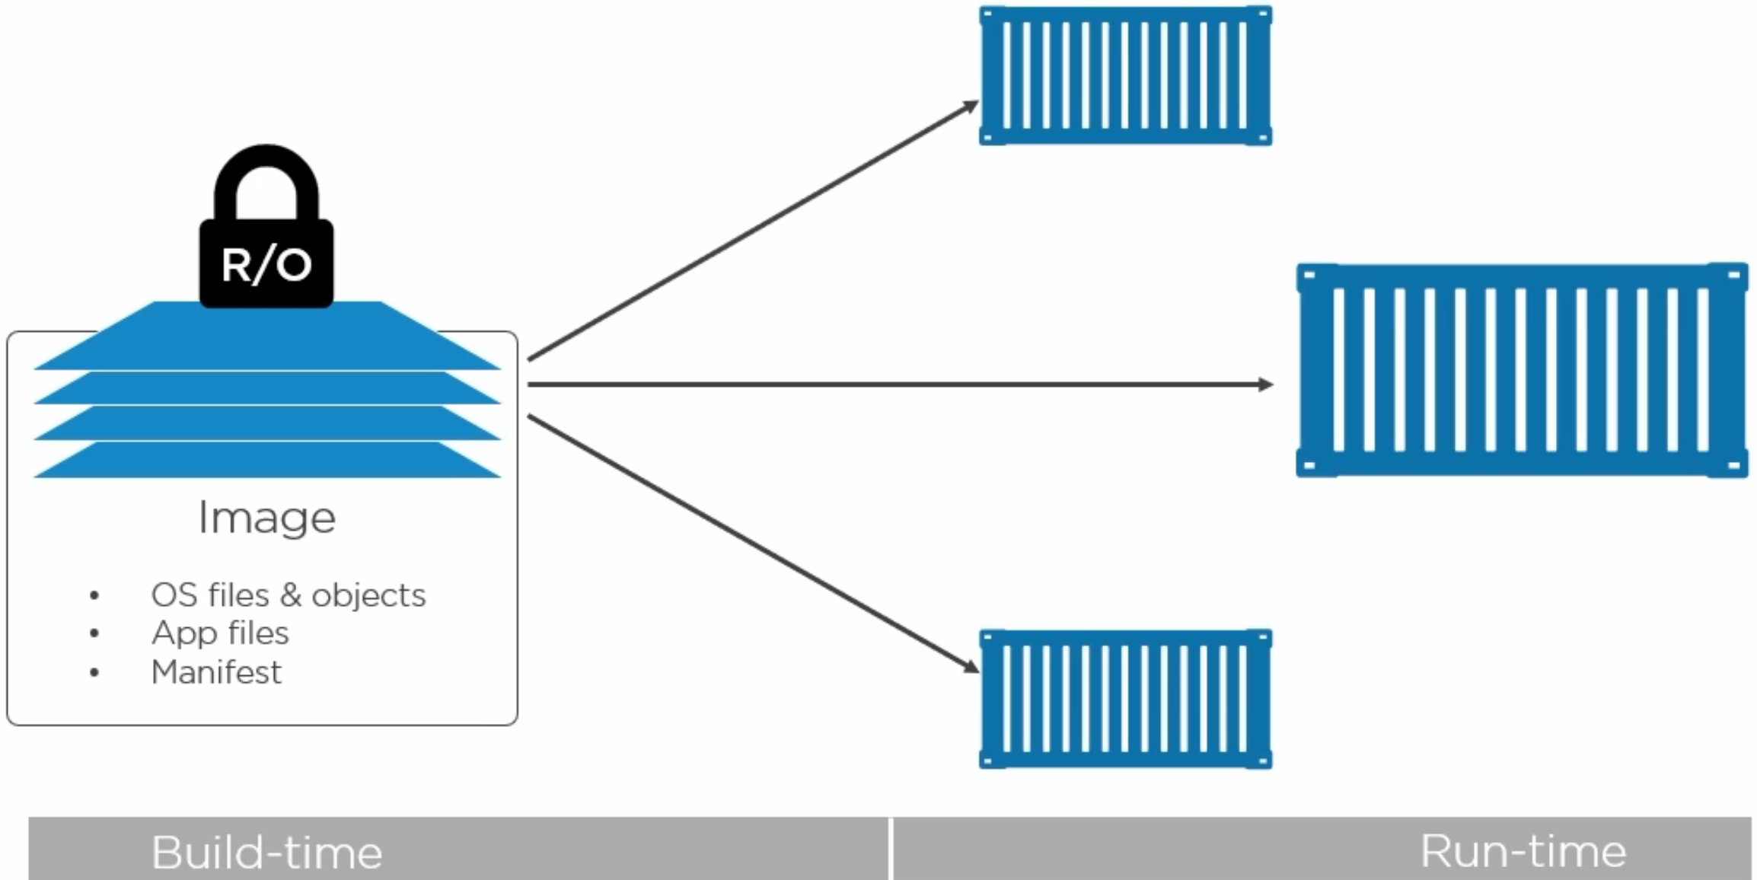
Docker Images

Slide 11
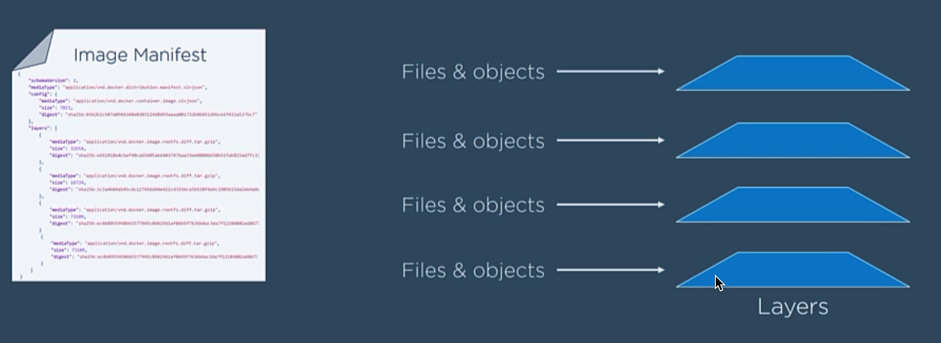
Image Itself

Slide 12
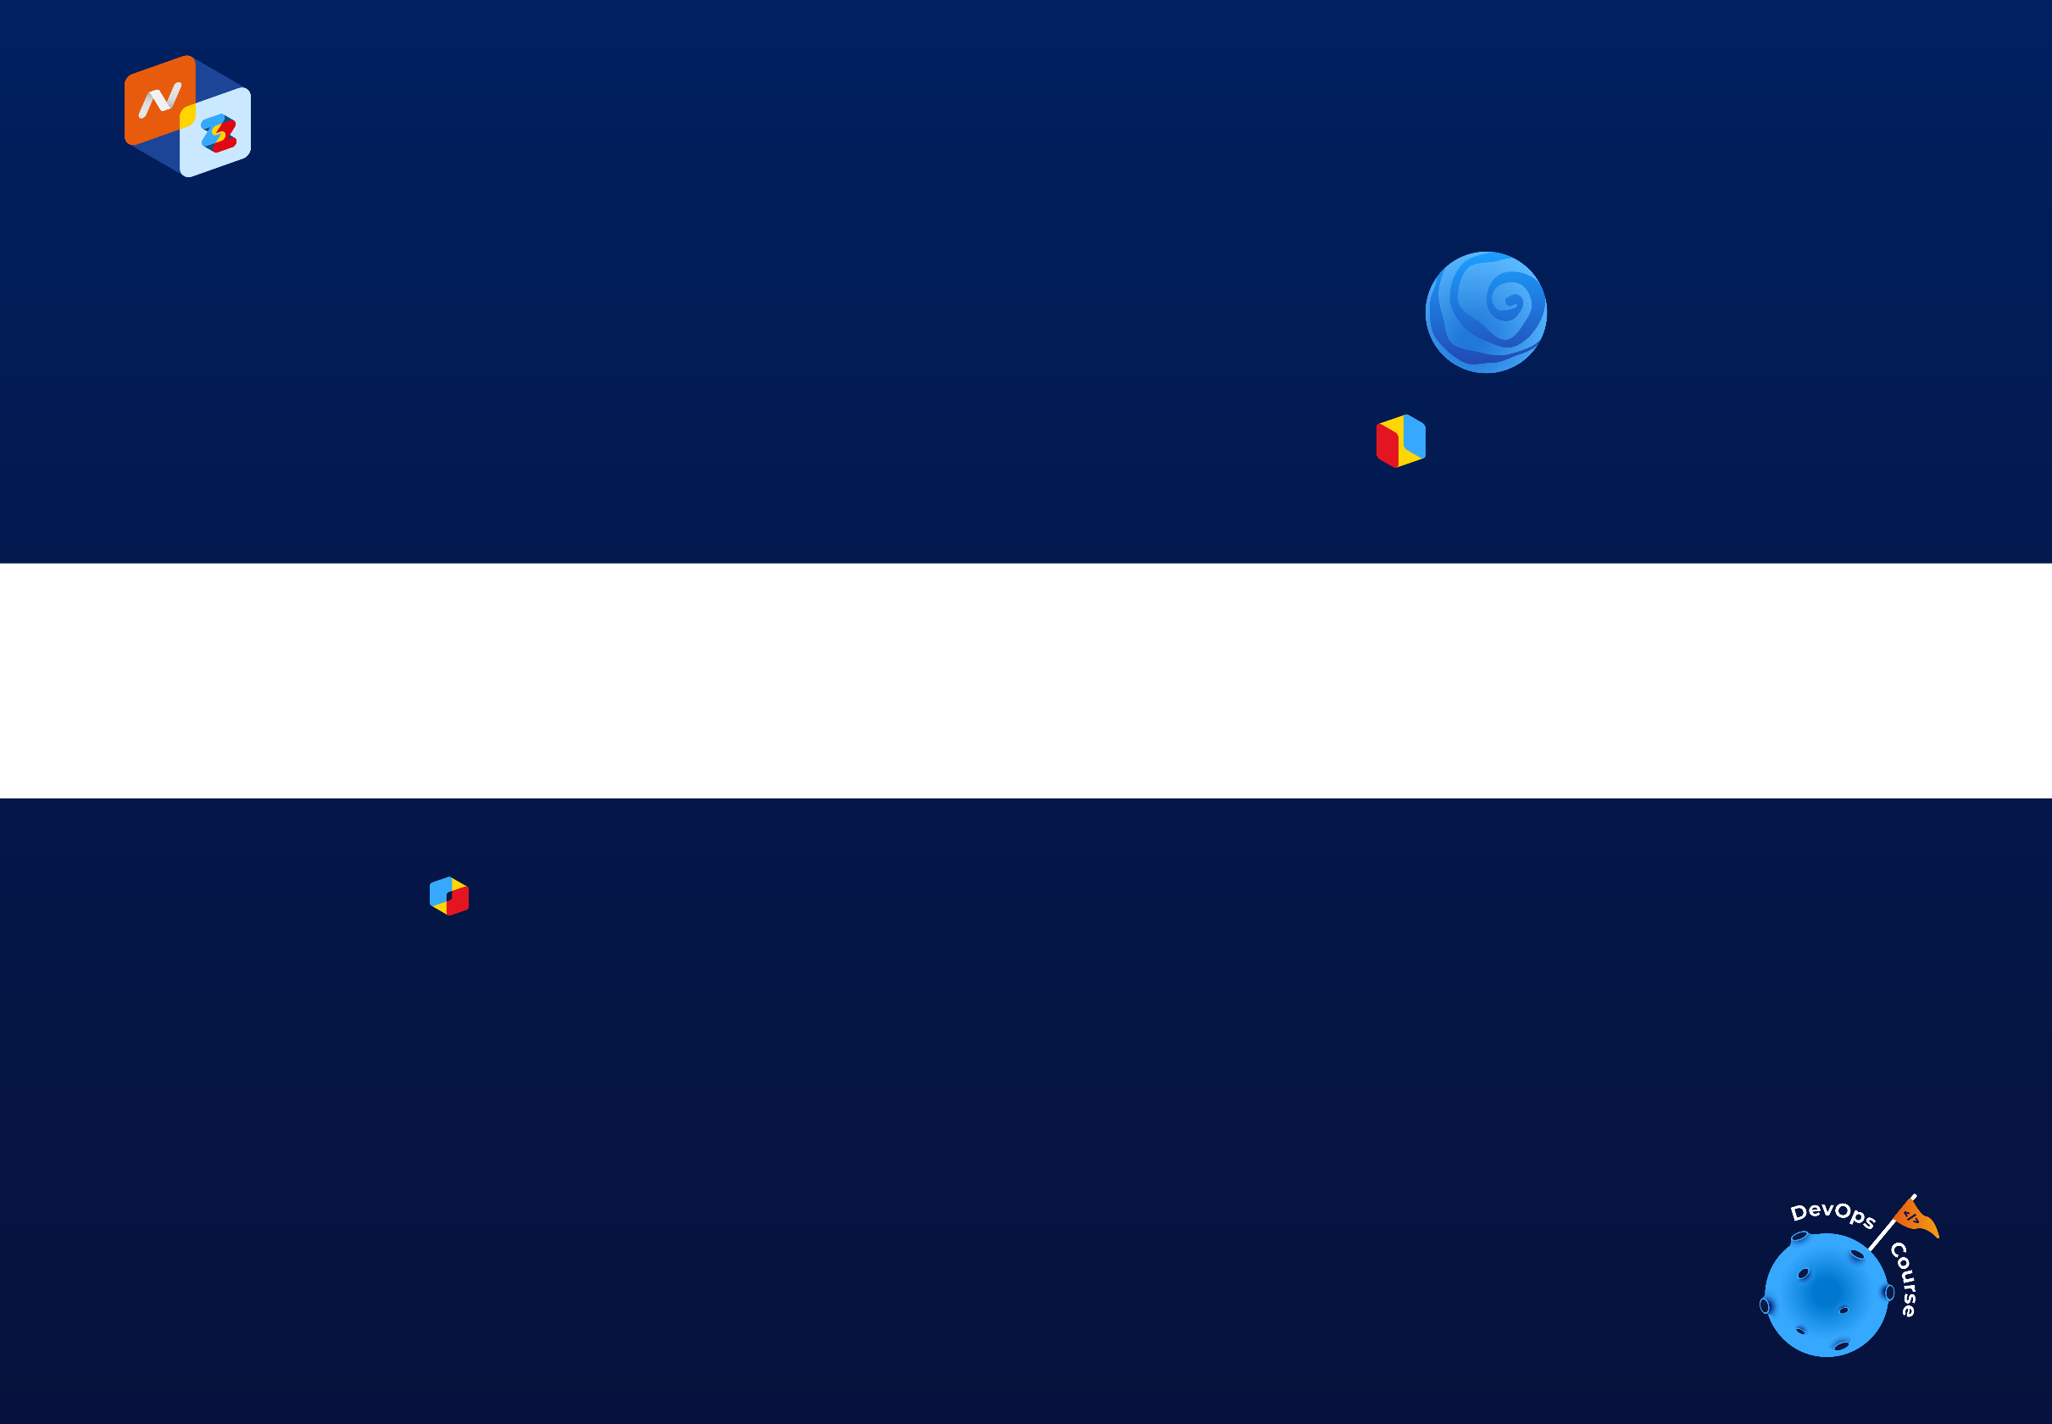
1. Pull Manifest
2. Pull Layers
Image Itself

Slide 13
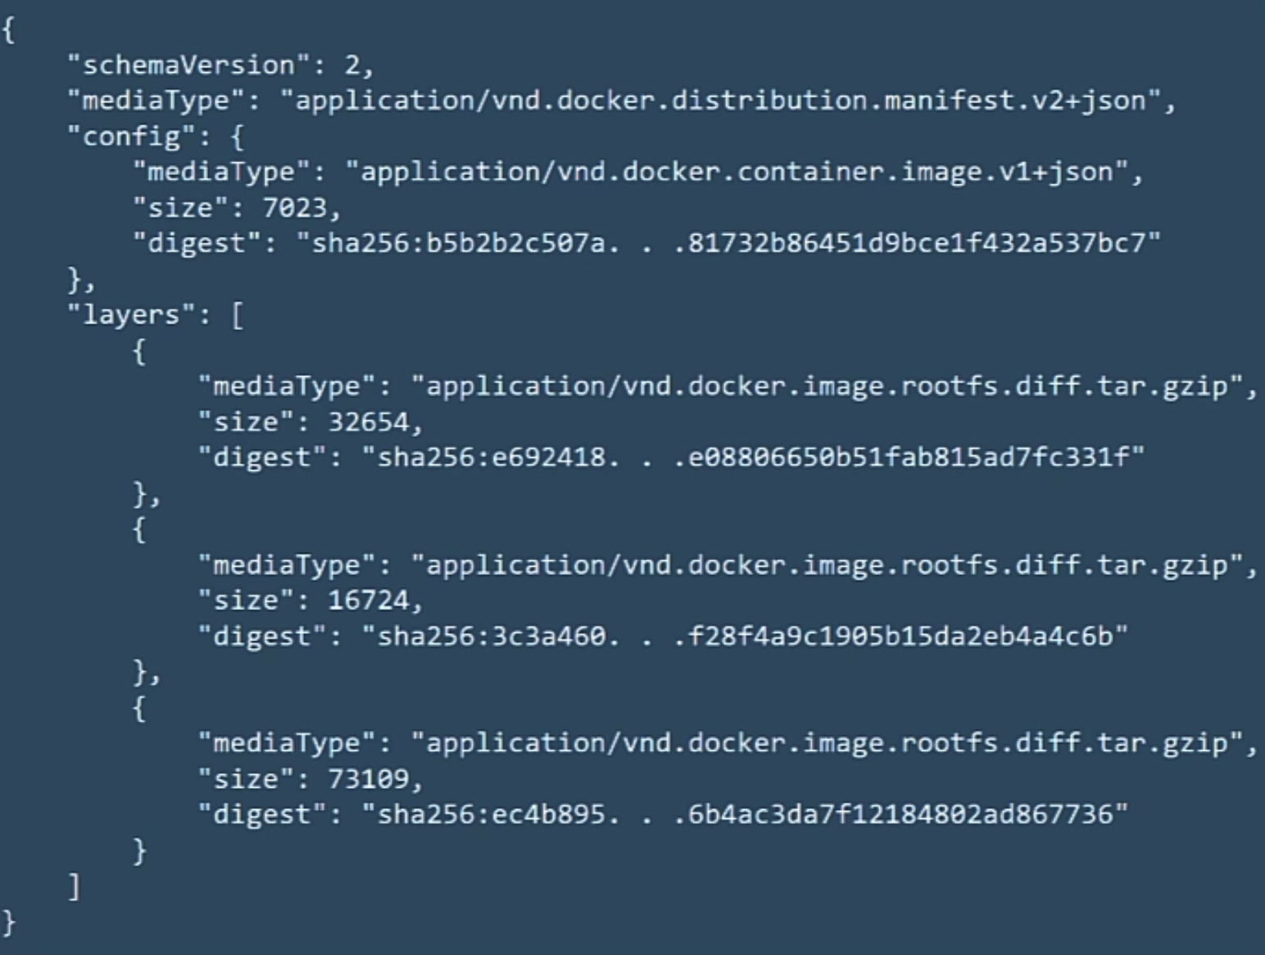
Manifest

Slide 14
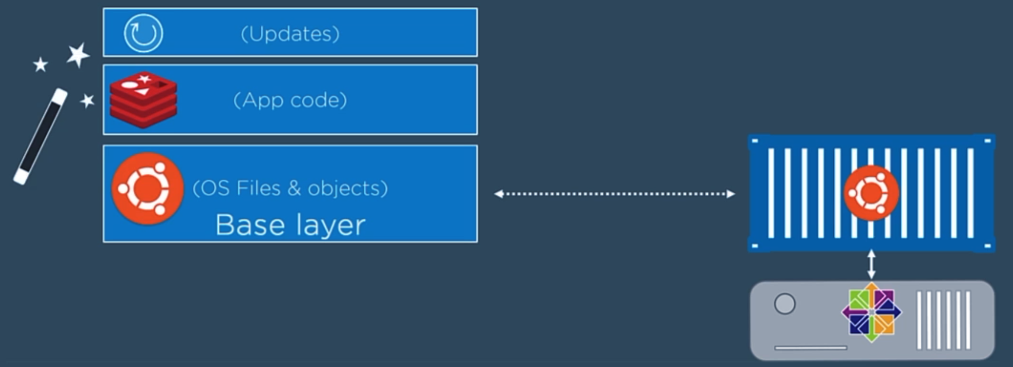
Layers

Slide 15
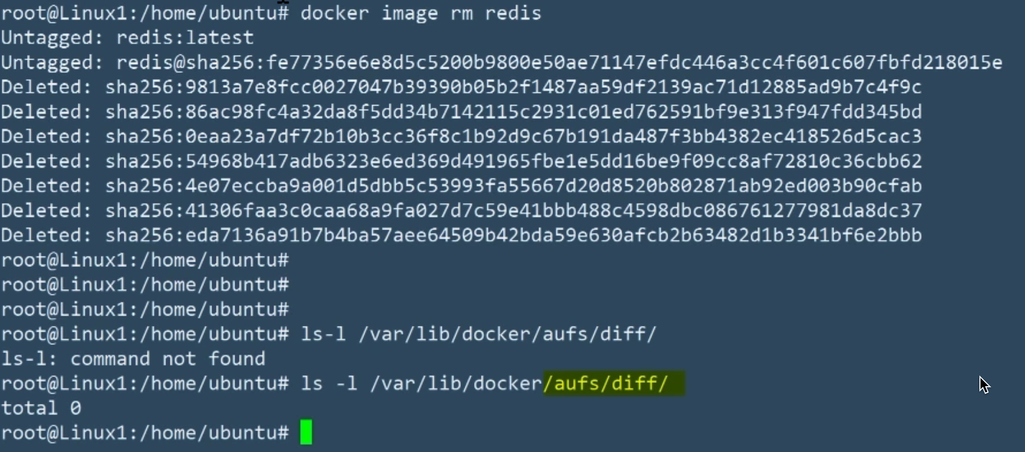
Where Layers Live

Slide 16
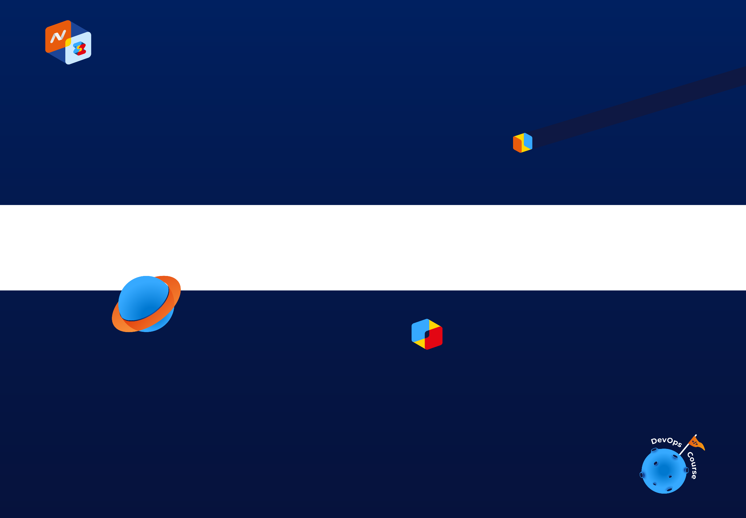
Registry

Slide 17
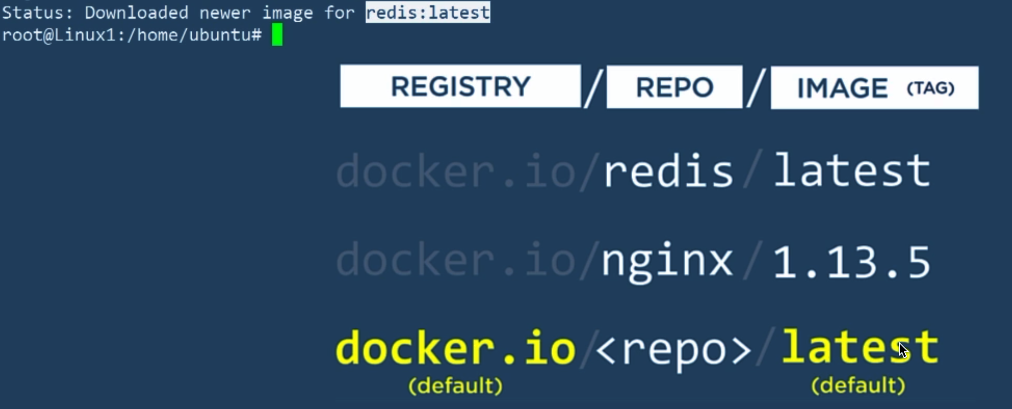
Registry

Slide 18
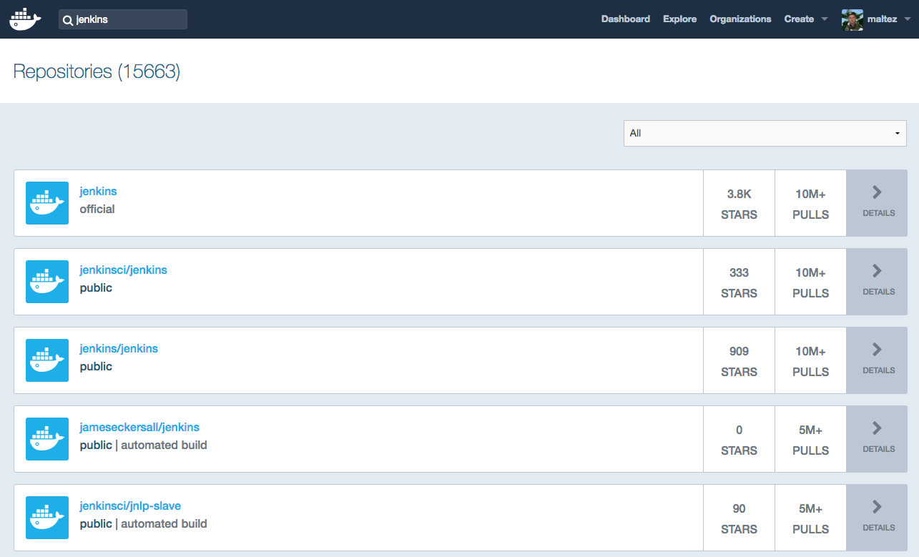

Slide 19
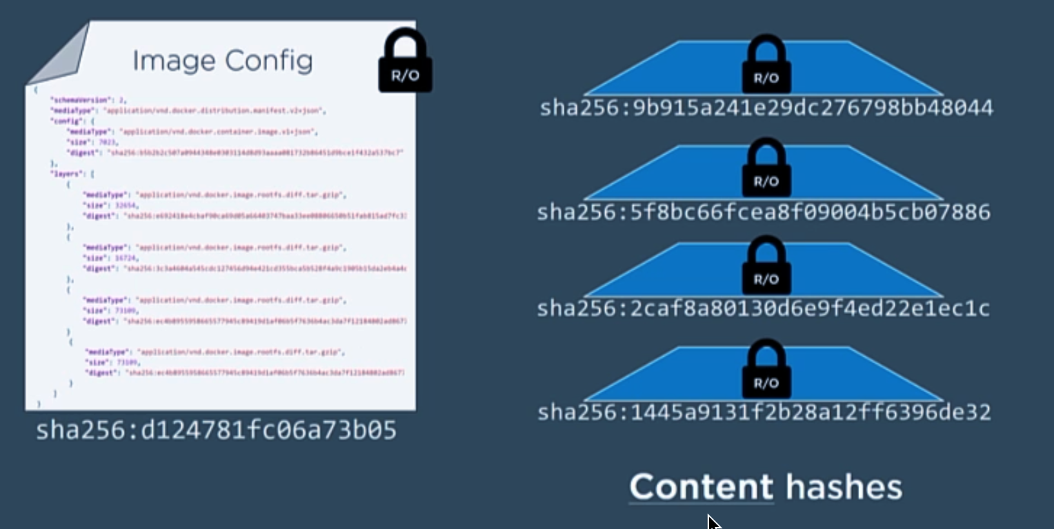
Security

Slide 20
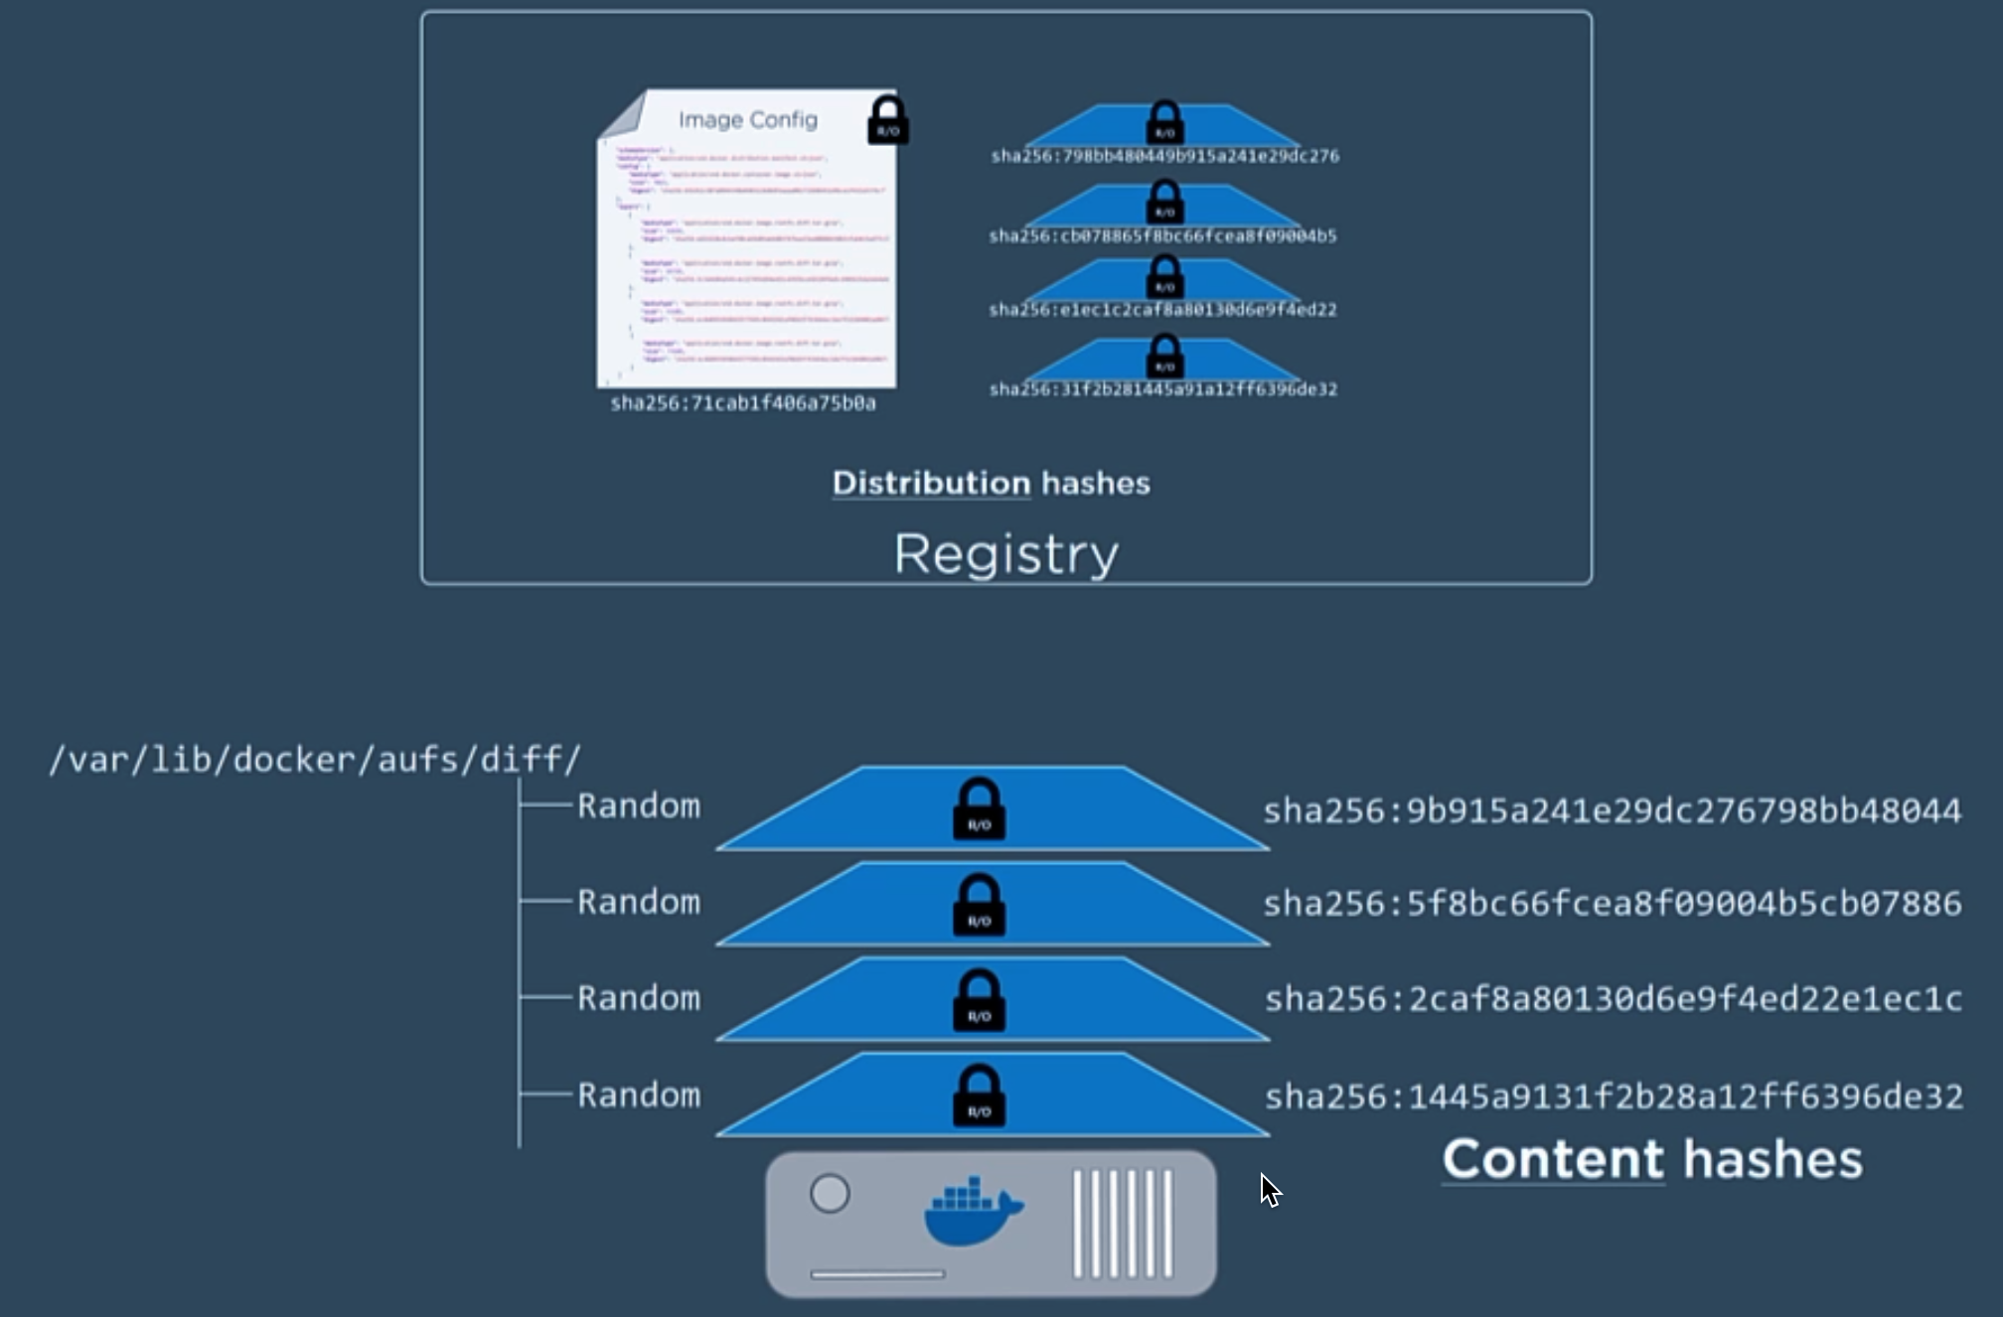

Slide 21
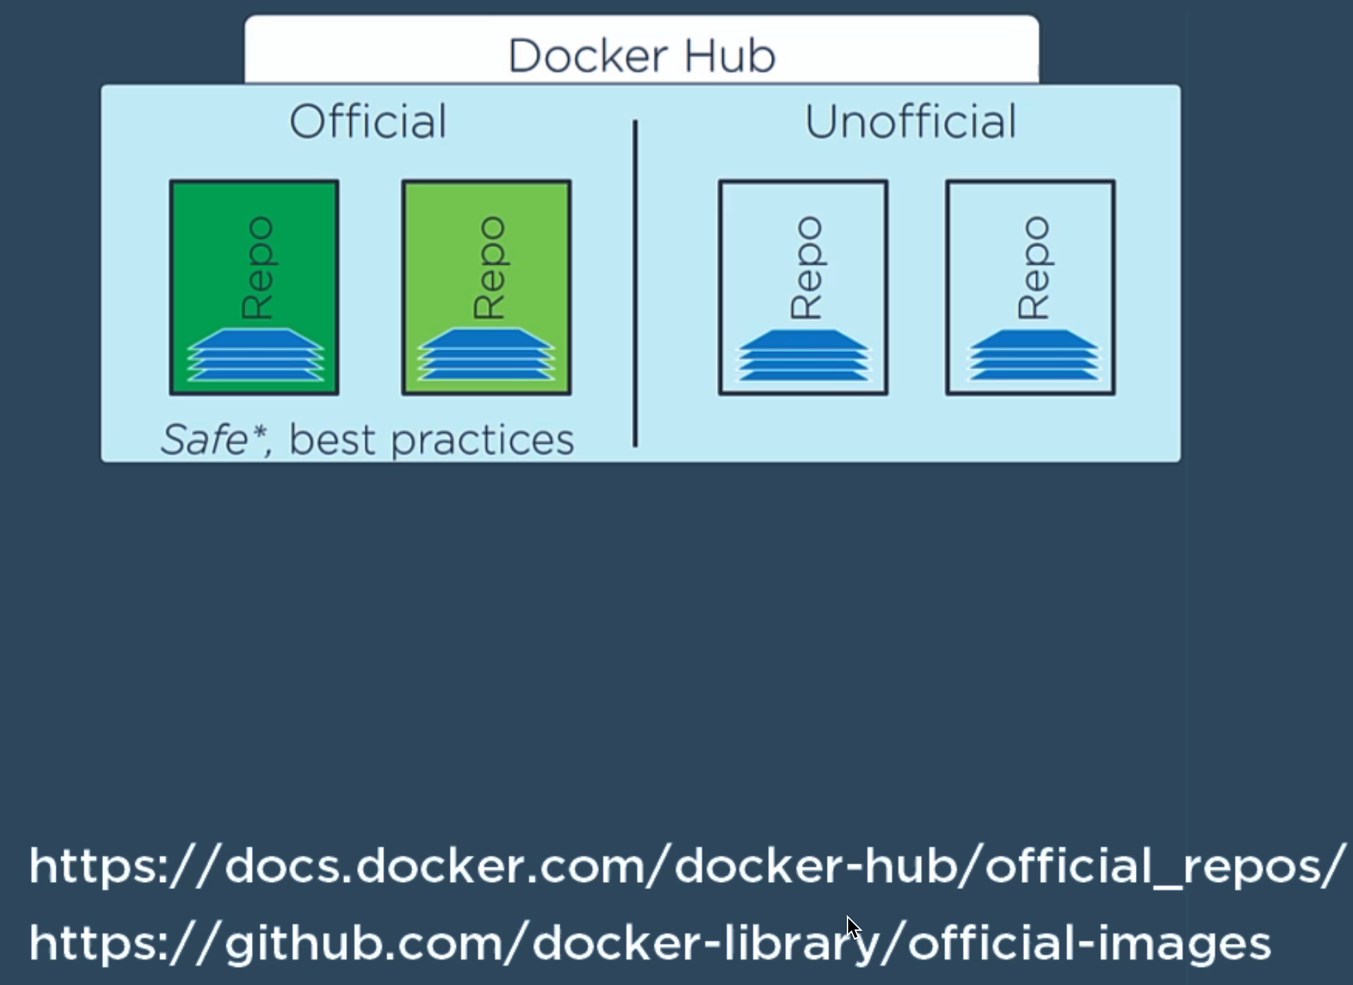
С

Slide 22
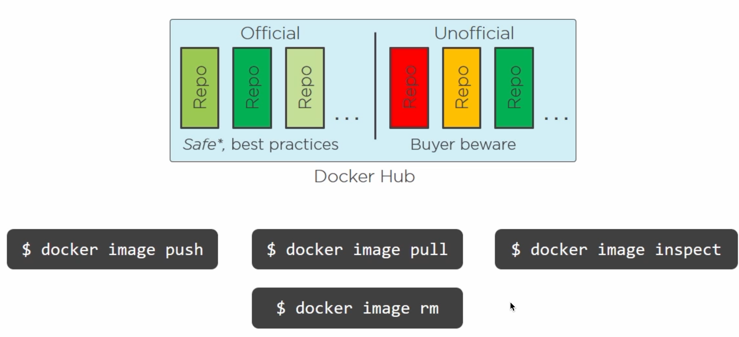
Image command

Slide 23
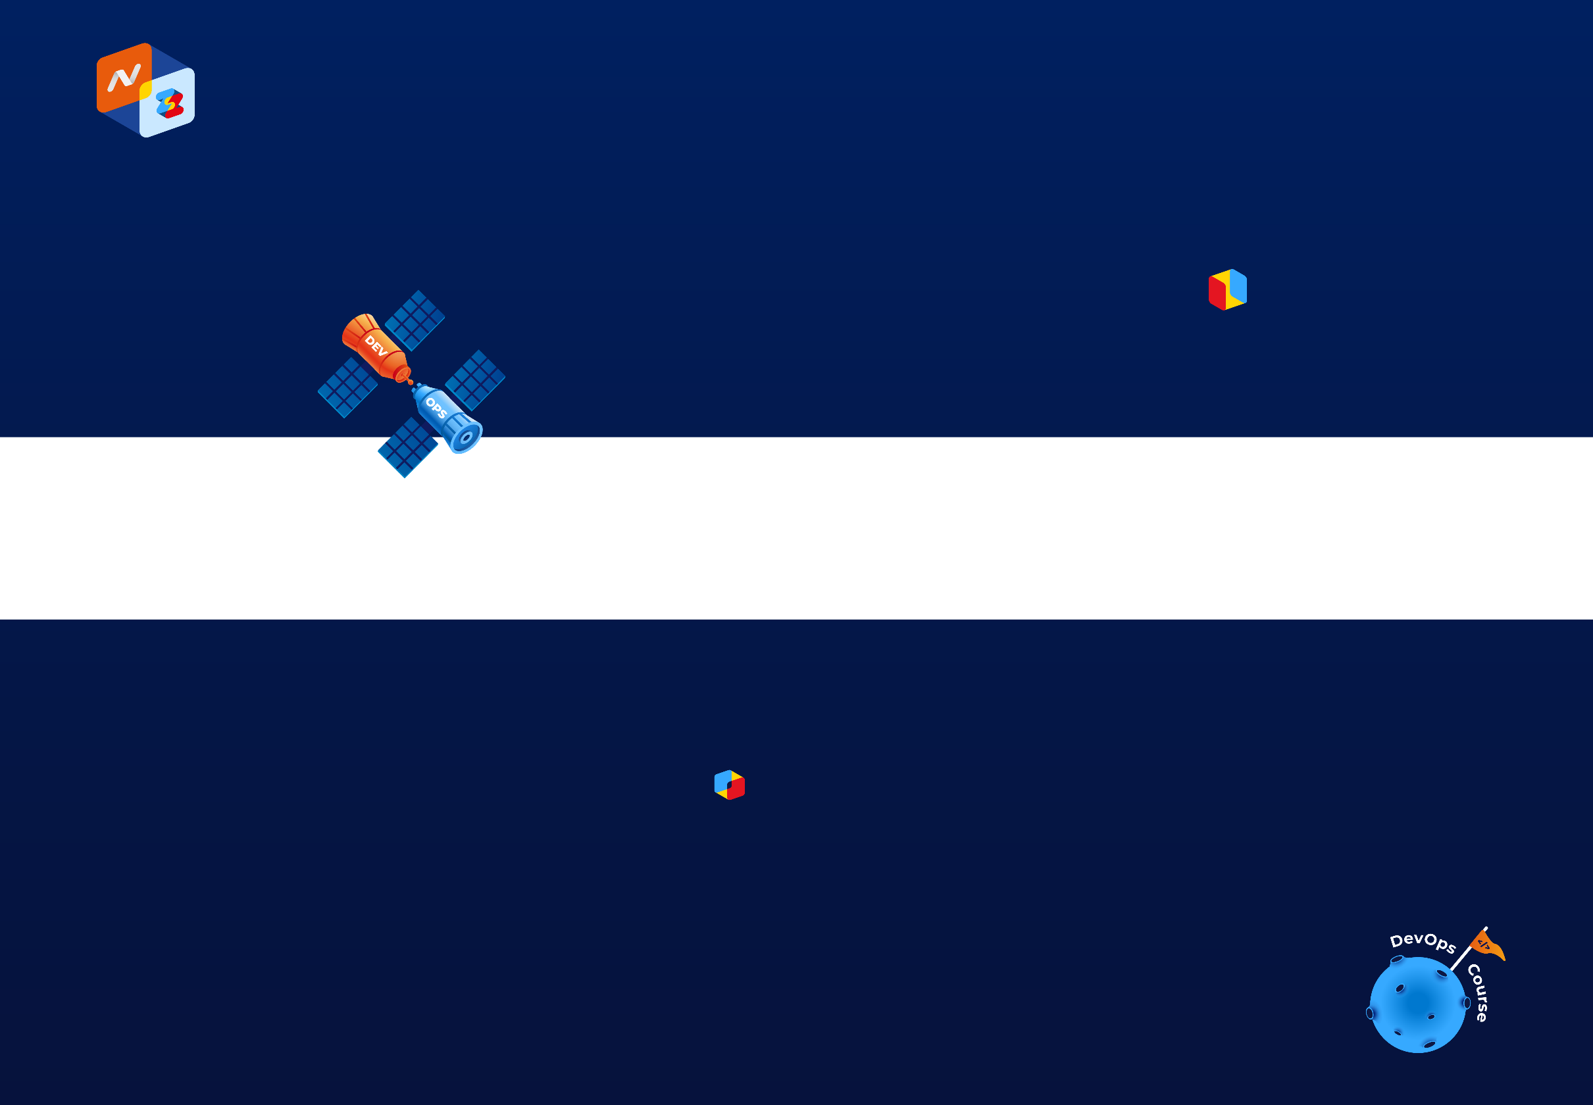
Dockerfile

Slide 24
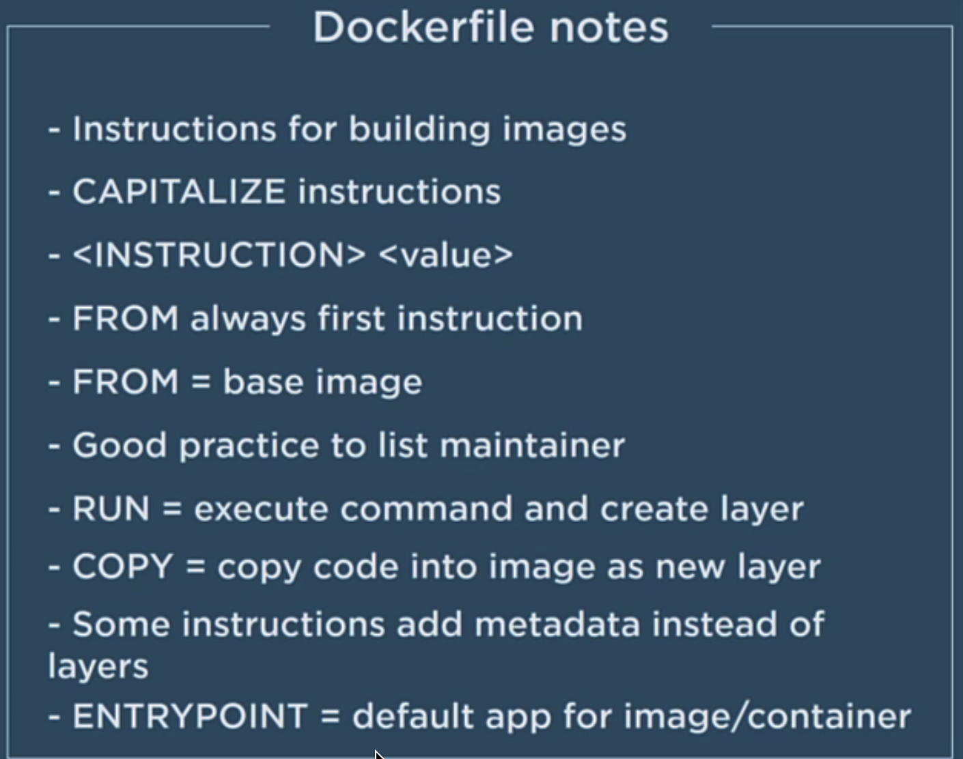
С

Slide 25
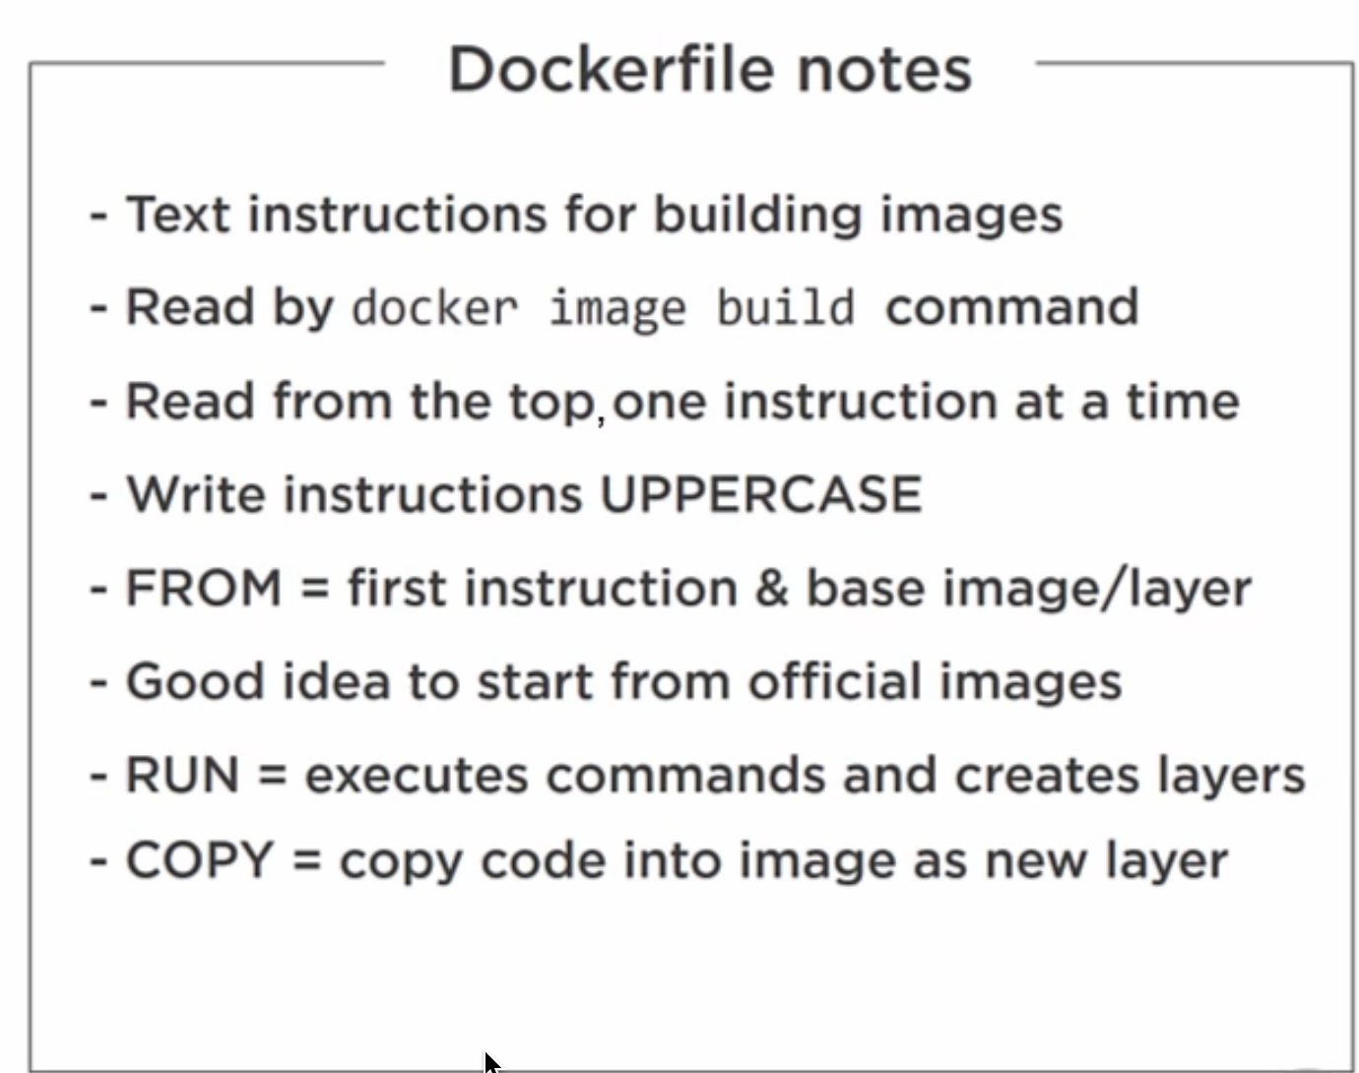
С

Slide 26
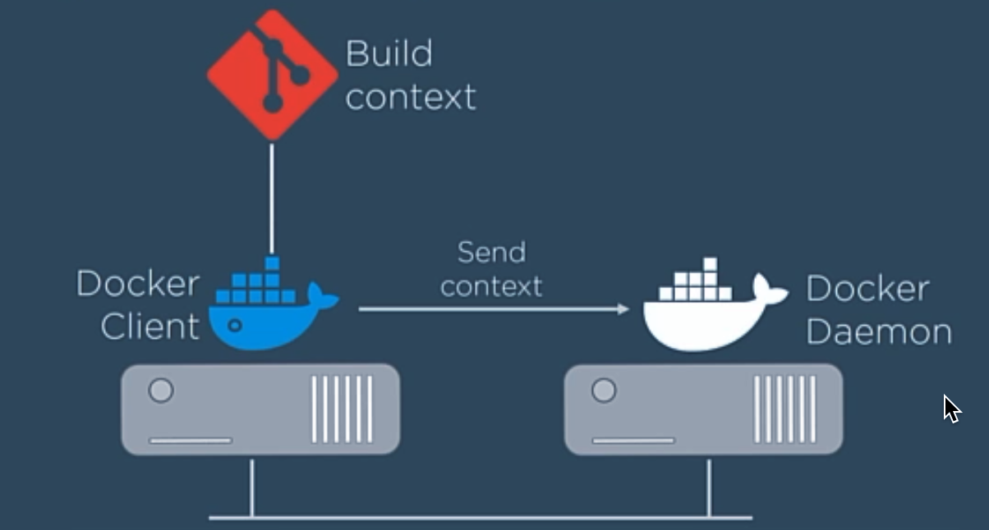
Build context
С

Slide 27
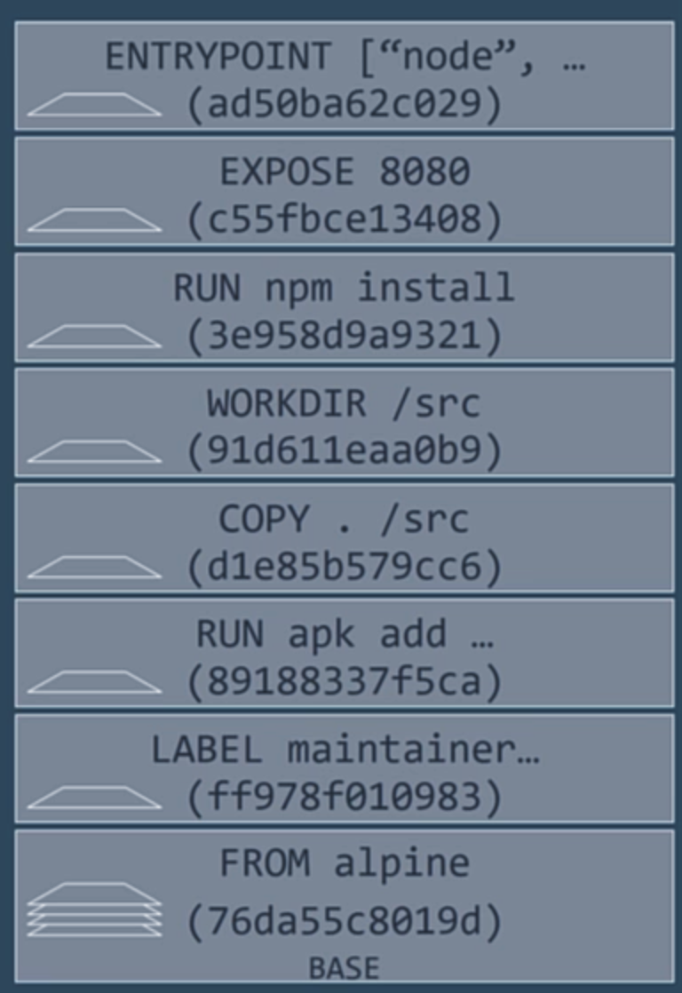

Slide 28
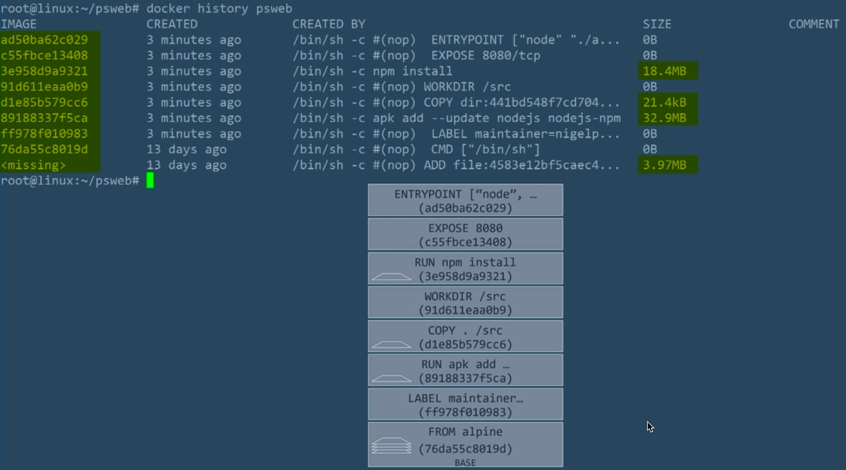
С

Slide 29
Dockerfile best practices
Use a .dockerignore file
Containers should be immutable & ephemeral
Minimize the number of layers / Consolidate instructions
Avoid installing unnecessary packages
Sort multi-line arguments
Build cache
Build every time
Dockerfile for Development Environment
Understand CMD and ENTRYPOINT

Slide 30

Containers

Slide 31
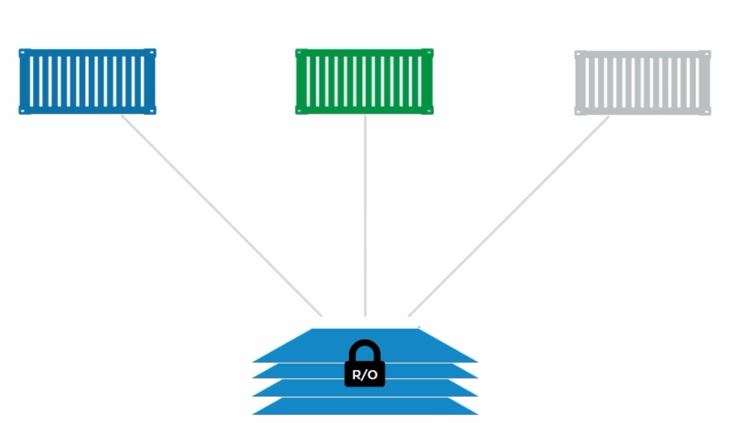
Containers

Slide 32
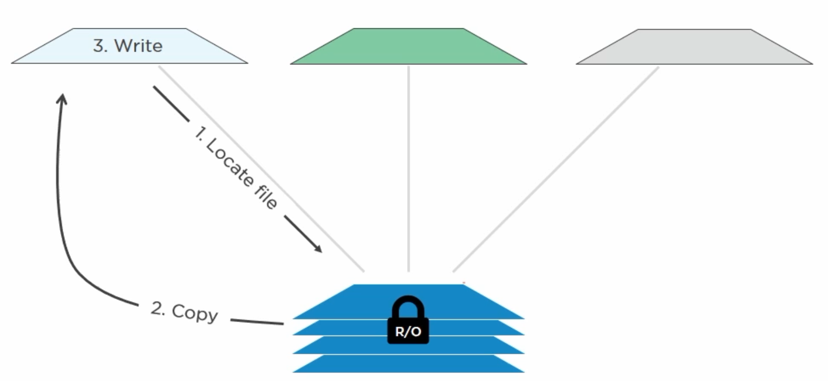
Containers

Slide 33
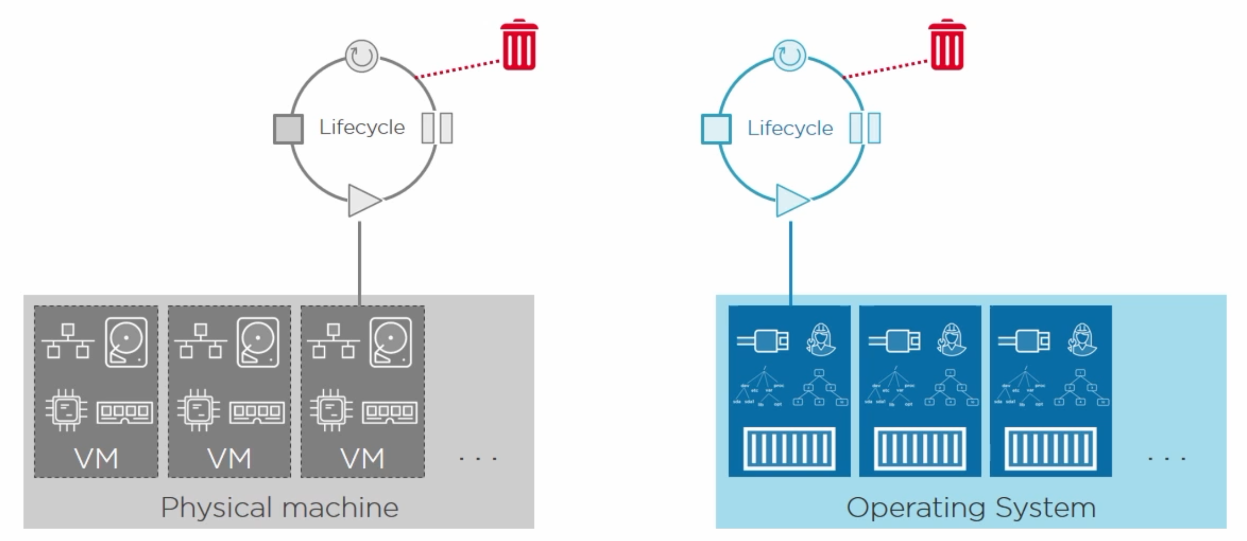
Containers

Slide 34
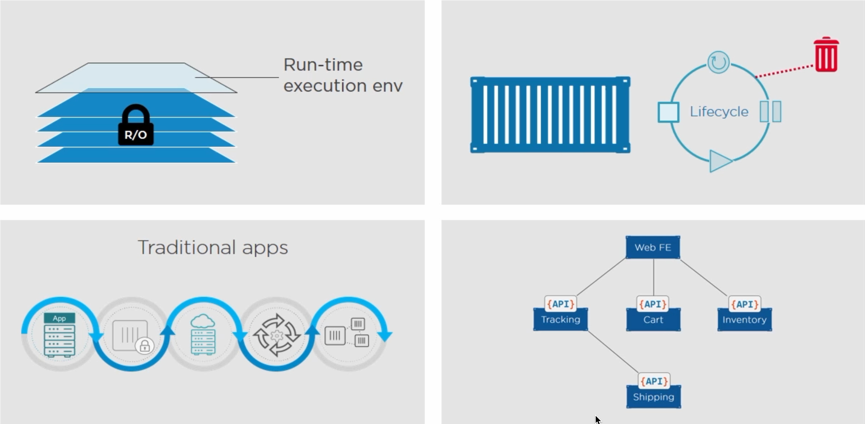
Containers

Slide 35
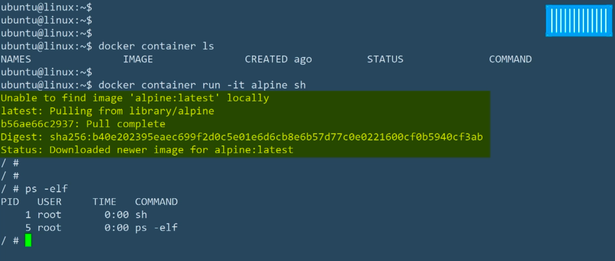
Containers
С

Slide 36
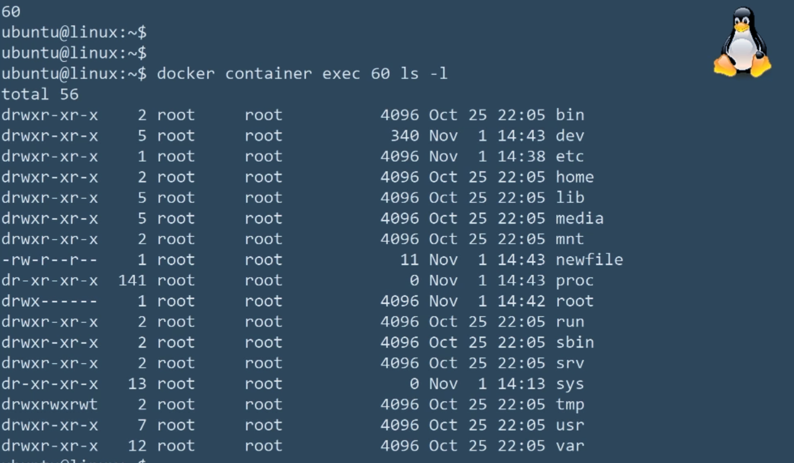
Containers
С

Slide 37
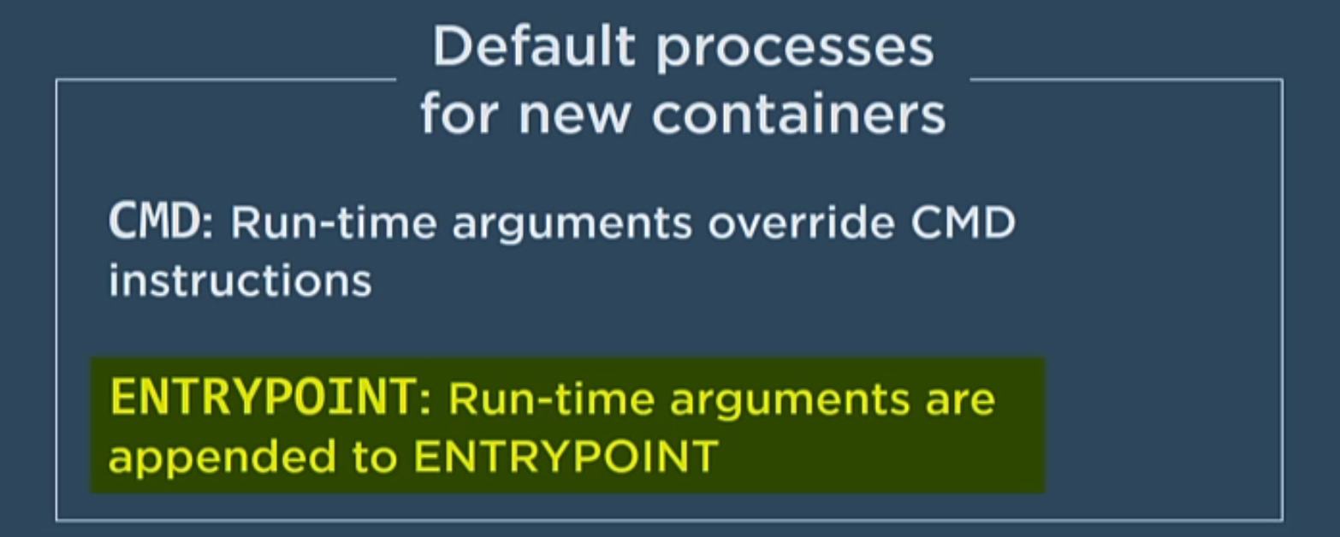
Containers
С

Slide 38

Logging

Slide 39
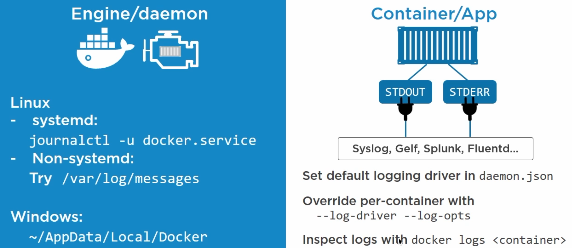
Logging

Slide 40
Main Commands

Slide 41
Main Docker Commands
docker pull <image_name>
docker images
docker ps -a
docker rm <id/container_name>
docker run --name <name> -dp <port#>:<port#> <image_name>
docker exec -it <name> <command>

Slide 42
Main Docker Commands
docker stop <container_name>
docker rm <id/container_name>
docker rmi <image_name>
docker rm $(docker ps -q -f status=exited)

Slide 43
Main Docker Commands
docker-compose up -d —no-deps
docker-compose down -t <time_in_sec>
docker-compose rm
exec <name> COMMAND [ARGS...]
docker-compose rm <id/container_name>
docker-compose restart -t <time_in_sec>

Slide 44

Questions ?

Slide 45

Thanks for attention!

